Slide 1
Comparative Analysis of Logistic Regression, Random Forest, and Deep Neural Networks for Diabetes Prediction

Slide 2
Research Gap
Diabetes is a significant global health issue with high health and economic consequences.
Early identification of high-risk individuals is crucial for timely intervention and prevention.
Machine learning models have potential for diabetes prediction but require comparative evaluation.
Gap: Need to identify the most effective predictive model using clinical and lifestyle data.

Slide 3
Aim (Research Question)
Aim:
Develop predictive models to predict diabetes outcomes based on clinical characteristics.
Conduct a comparative study of machine learning methods to select the most effective model for early detection and prevention.
Research Question:
How does a Deep Neural Network (DNN) compare to Logistic Regression and Random Forest in predicting diabetes outcomes based on clinical features?

Slide 4
Research Objectives
Objectives:
Compare performances of Logistic Regression, Random Forest, and DNN models.
Assess impact of data preprocessing and feature selection on model performance.
Evaluate clinical characteristics (BMI, glucose, HbA1c) as predictors.
Provide practical insights for early intervention and prevention.

Slide 5
Dataset Background
Dataset from UCI Machine Learning Repository: Diabetes data from 130 US hospitals (1999-2008).
Over 101,000 patient encounters with 50+ attributes: demographics, clinical, lifestyle factors.
Synthetic but realistic clinical data, anonymized and GDPR compliant.
Primary variable: binary diabetes presence for supervised learning.
Combines demographic, clinical, and lifestyle data for rich predictive modelling.

Slide 6
Preprocessing and Feature Engineering
Replaced '?' with NaN; dropped columns with >40% missing data.
Filled missing categorical values with mode; numerical with median.
Dropped duplicates and reset index.
Created binary target variable 'readmitted_binary'.
Extracted numerical age midpoint from age ranges.
Dropped irrelevant columns: encounter_id, patient_nbr, readmitted, age.
Encoded categorical variables using LabelEncoder.
Split data into training and testing sets with stratification.

Slide 7
Model Training
Deep Neural Network:
Baseline Scaled: Acc=0.6298, F1=0.5906
DNN Opt1: Acc=0.6334, F1=0.5732
DNN Opt2: Acc=0.6321, F1=0.5726
Random Forest:
Baseline: Acc=0.6329, F1=0.5647
Optimized: Acc=0.6425, F1=0.5630
Logistic Regression:
Baseline: Acc=0.6192, F1=0.5559

Slide 8
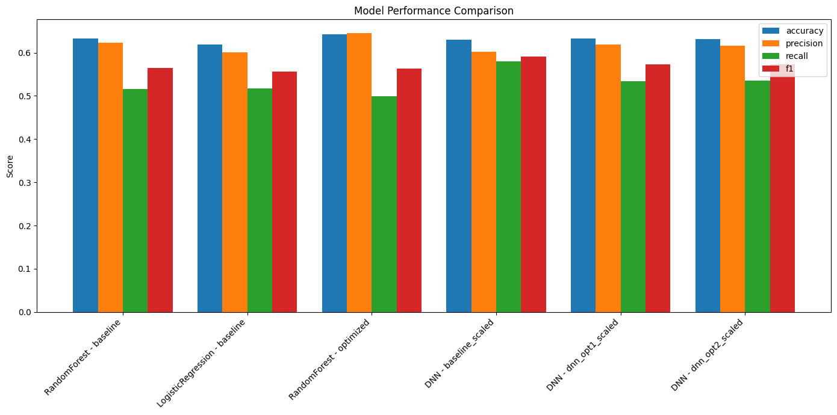

Slide 9
Results
Random Forest (optimized) achieved the highest accuracy (0.6425).
DNN (baseline scaled) achieved the best F1-score (0.5906).
Logistic Regression performed competitively with balanced metrics.
All models produced similar accuracy ranges (0.62–0.64).
Scaling and class weighting improved DNN performance significantly.

Slide 10
Conclusion
Successfully developed and compared Logistic Regression, Random Forest, and DNN models.
Random Forest achieved the highest accuracy, while the scaled DNN produced the best F1-score.
Clinical and lifestyle features contributed meaningfully to prediction performance.
Different models excelled in different metrics, aiding informed model selection.
Preprocessing steps, including scaling and handling imbalance, were critical for improved results.

Slide 11
Future Work
Explore additional machine learning and deep learning models.
Apply advanced feature selection and dimensionality reduction.
Incorporate longitudinal data for temporal modeling.
Enhance model interpretability for clinical adoption.
Validate models on external datasets.
Develop clinical decision support tools based on best models.

Slide 12
References
American Diabetes Association, 2023. Standards of Medical Care in Diabetes—2023. Diabetes Care, 46(Supplement 1), pp. S1–S216.
Breiman, L., 2001. Random Forests. Machine Learning, 45(1), pp. 5–32.
Choudhury, A., Asan, O. and Le, T., 2020. Comparative Analysis of Machine Learning Approaches for Diabetes Prediction. Health Informatics Journal, 26(3), pp. 1982–1996.
Clore, J., Cios, K., DeShazo, J., Strack, B., Gennings, C., Olmo, J. and Ventura, S., 2014. Diabetes 130-US hospitals for years 1999–2008. UCI Machine Learning Repository.
Hosmer, D.W., Lemeshow, S. and Sturdivant, R.X., 2013. Applied Logistic Regression. 3rd ed. Hoboken: Wiley.
Kavakiotis, I., Tsave, O., Salifoglou, A., Maglaveras, N., Vlahavas, I. and Chouvarda, I., 2017. Machine Learning and Data Mining Methods in Diabetes Research. Computational and Structural Biotechnology Journal, 15, pp. 104–116.
Strack, B., DeShazo, J., Gennings, C., Olmo, J., Ventura, S., Cios, K. and Clore, J., 2014. Impact of HbA1c measurement on hospital readmission rates: Analysis of 70,000 clinical database patient records. BioMed Research International, 2014, Article ID 767340.
World Health Organization, 2021. Global report on diabetes. Geneva: WHO.

Slide 13
Thank You

